Slide 1

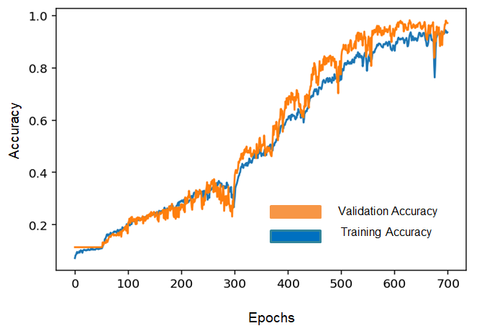
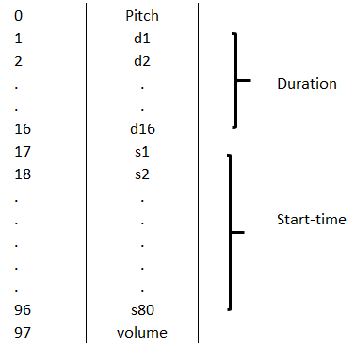
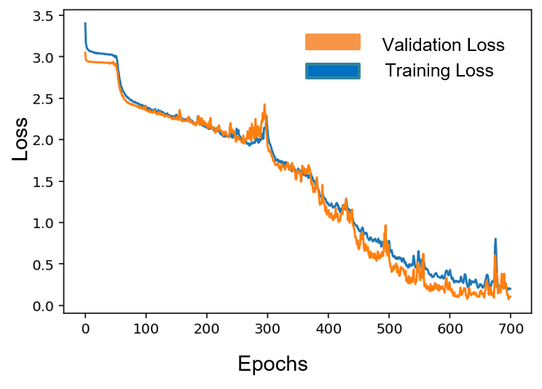
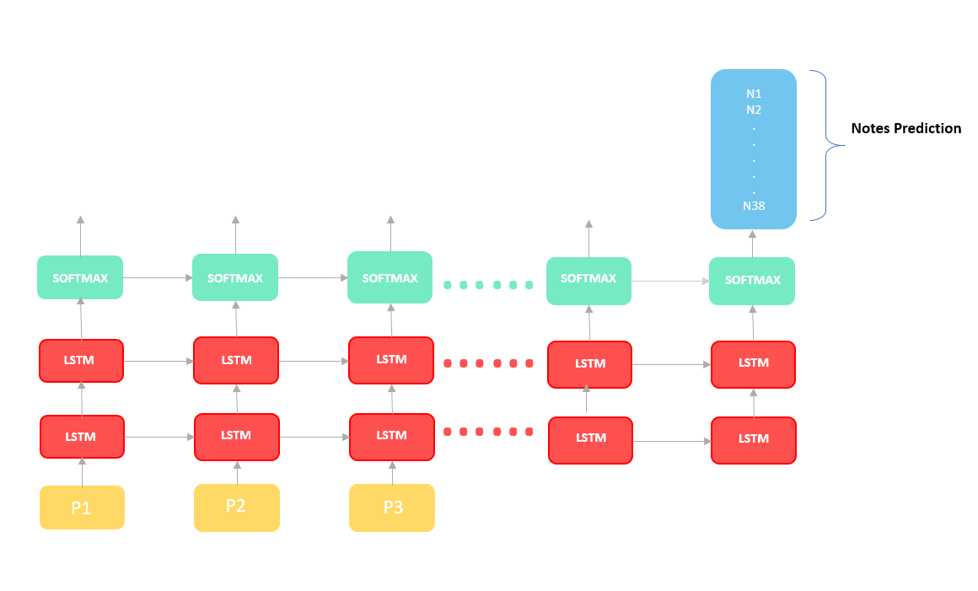
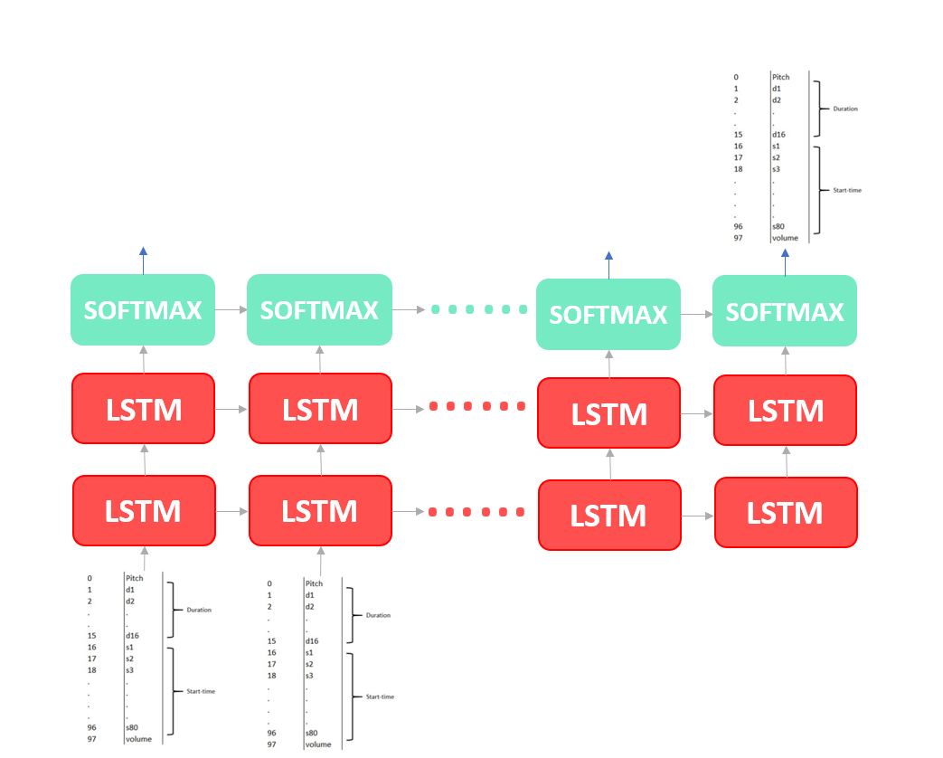
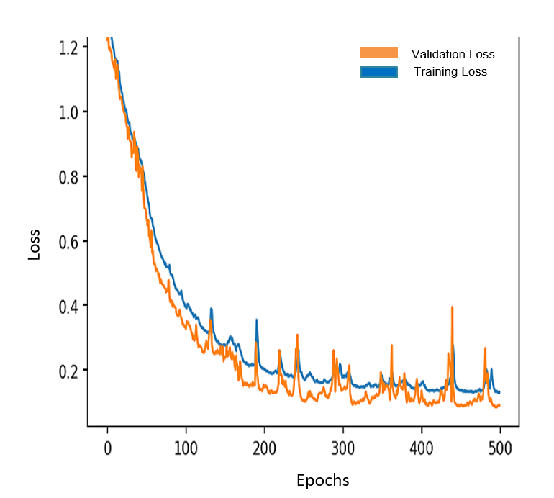
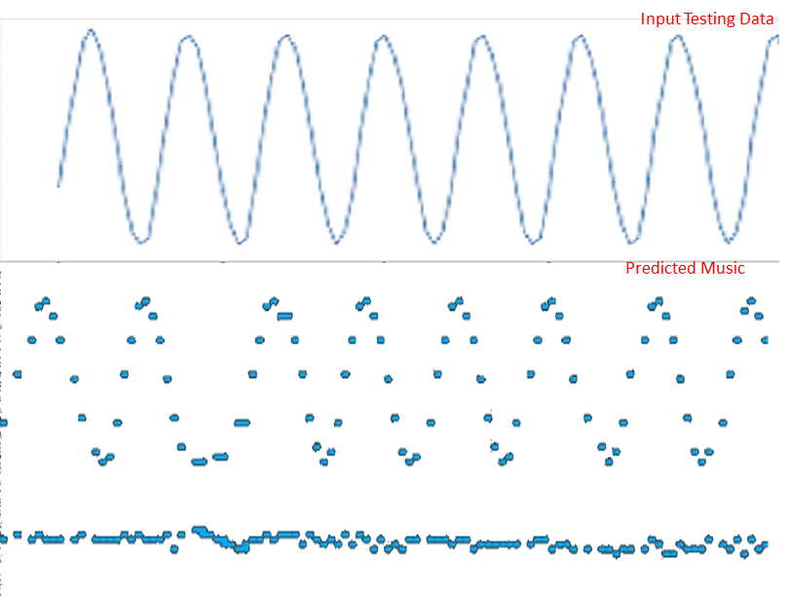
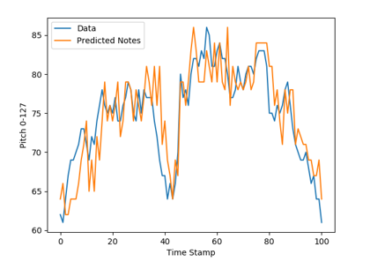
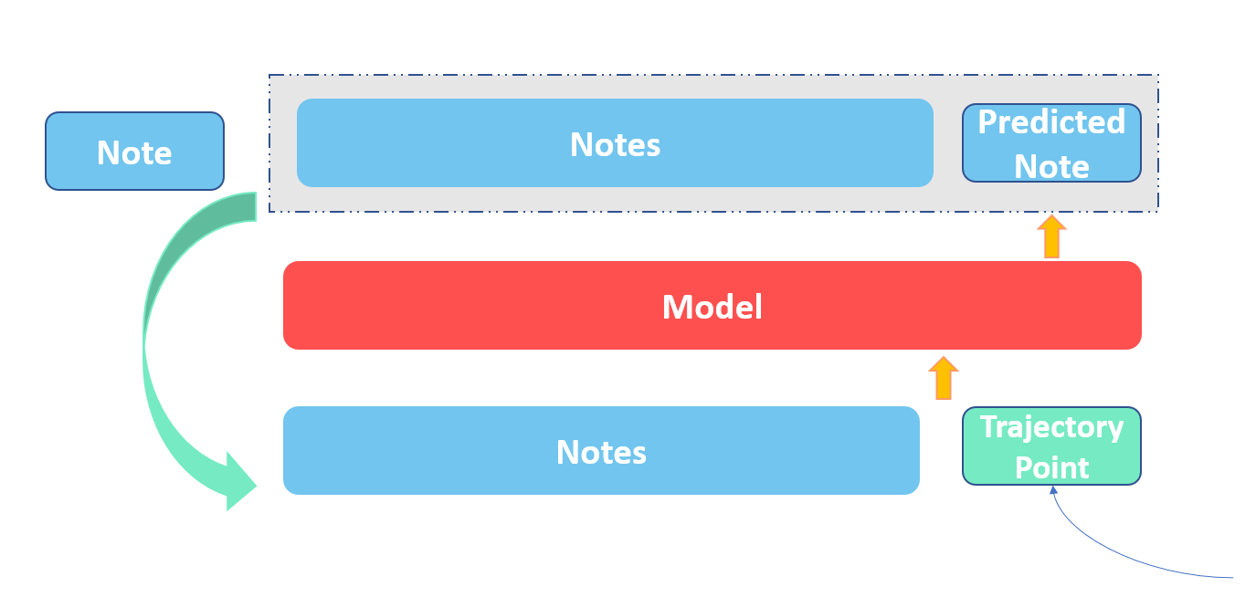
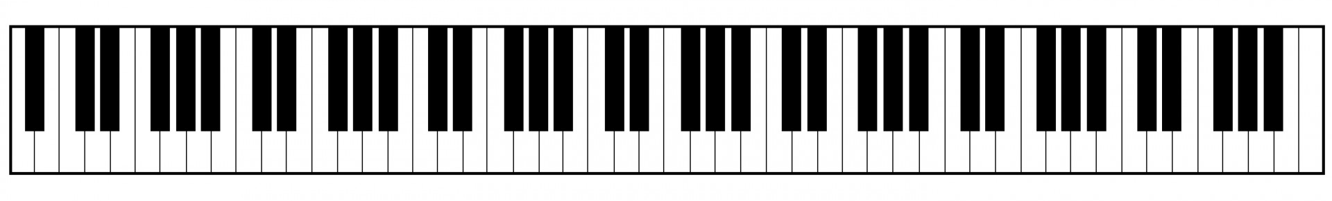
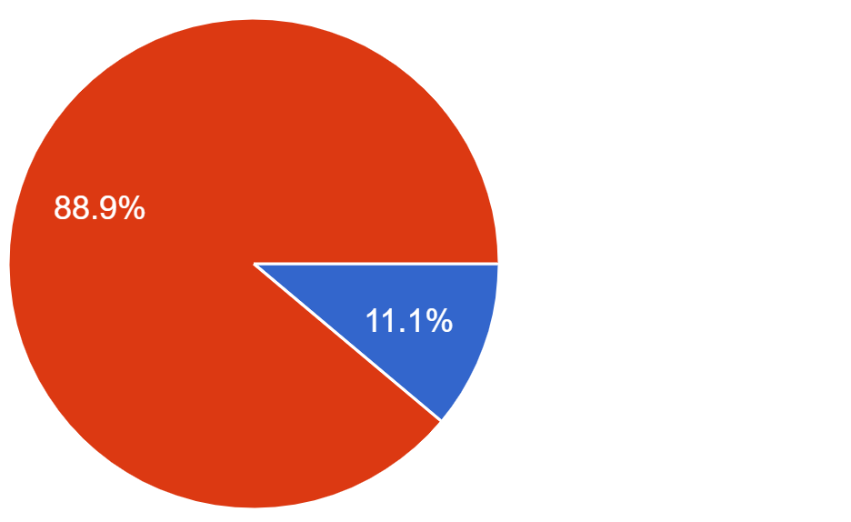

Music Is All You Need To Analyze Data
Jatin Dawar, Prem Raheja, and Utkarsh Vashisth
Department of Computing Science, University of Alberta
Abstract
Models
Discussion
Our goal is to transform any time-series data into a musical form using deep learning techniques in order to present a unique way to interact with data. Specifically, the goals are 1) to generate melodious music, i.e. music that is soothing to ears 2) to generate music which reflects information present in the underlying data.
We develop two approaches: 1) Pitch based approach, where our model is trained to generates music with pitch of every note representing the underlying user data.2) Temporal based approach, where the generated music notes not only represents the underlying data but also posses temporal features making the generated music soothing to listen. melody.
We evaluate the success of these methods with a survey designed to assess the two goals of the project.
Pitch Based Approach
Temporal Based Approach
The data sonification using the developed LSTM model is better than other existing sonification tools.​
The generated music not only follows the pattern but also is soothing to ears.​
The model automatically tunes itself to various parameters like velocity, start time of the notes and the duration of the notes.​
The model is flexible to any time-series data
To fully analyze the success of the model in achieving both goals outlined, we would need a survey with a much larger sample size both in number participants and number of generated audio clips.
Convolution over each musical piece
Supervised: predict next note based on previous 50 notes
Exploit the relationship between the notes and force the predicted note to generate sound in accordance to the user input data.
Considered music properties like velocity, start time and duration along with pitch of each note.
Each note is a 98-Dimensional vector
Supervised: predict next vector based on previous 50 notes
Exploit the relationship between the notes and force the predicted note generate sound in accordance to the user input data.
Model Architecture
Model Architecture
Input vector
Architecture:
LSTM layer 1 with 256 hidden units
LSTM layer 2 with 38 hidden units
Dense layer with softmax activation function
Architecture:
LSTM layer 1 with 256 hidden units
LSTM layer 2 with 256 hidden units
Dense layer with softmax activation function
Future Work
Future efforts include the need to consider factors like rhythm, tempo beats in order to make the music generation more realistic and pleasing to hear. We will also like to explore other generative models like GANs to check if the results can be improved further.
With the help of our model, we desire to solve real world problems like Parkinson disease where patients suffering from Parkinson Disease would be able to correct their unsteady gaits by listening to the music generated by their steps.
Datasets
Training Data
Music generation from Testing Data
MIDI data format
300 classical piano pieces
Simplified using music21 , mido and pretty_midi packages in Python to extract important features of music.
Temporal approach result
Results
Most piano pieces have melodies in pitch range 21-108
Goal 1: Generated music soothing to ears
Goal 2: matching generated music to trajectory
References
Two Tone
[1] S. Hananoi, K. Muraoka, and Y. Kiyoki, “A music composition system with time-series data for sound design in next-generation sonification environment,” in 2016 International Electronics Symposium (IES), 2016, pp. 380–384.
[2] Classical piano midi page. Retrieved from http://www.piano-midi.de/
[3] Holzner, A. LSTM Cells in Pytorch. Retrieved from https://medium.com/@andre.holzner/lstm-cells-in-pytorch-fab924a78b1c
[4] TwoTone. TwoTone, twotone.io/.
Testing Data
Our Approach
Testing data could be any time- series data in the form of a csv that needs to be analyzed
(User Input Data)
Survey results with 18 participants showing % who prefer listening to music generated using our approach compared to music generated using software
Percentage of participants predict correct trajectory based on the music
Generated music notes based on the input data

